Slide 1
Building Blocks of a Webapp

Slide 2
Agile-Scrum Process

Slide 3
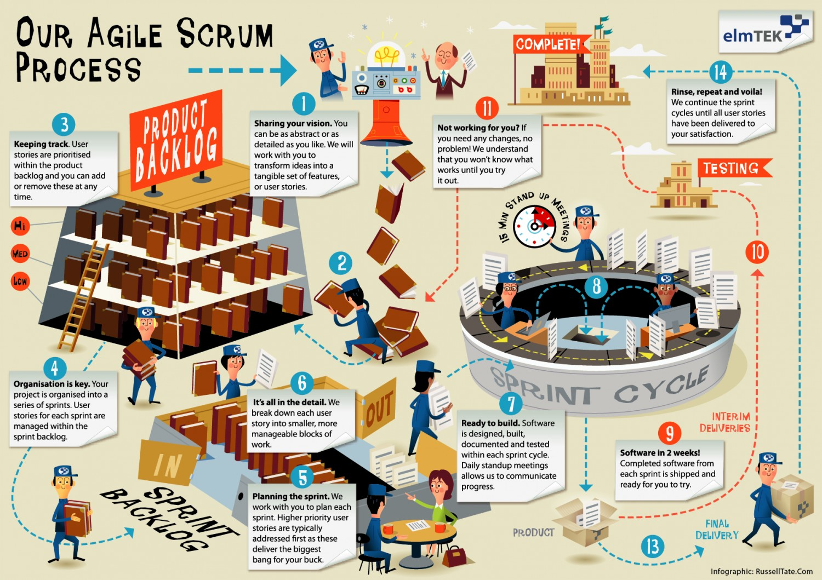
A Project Management Framework

Slide 4
A Webapp Stack

Slide 5
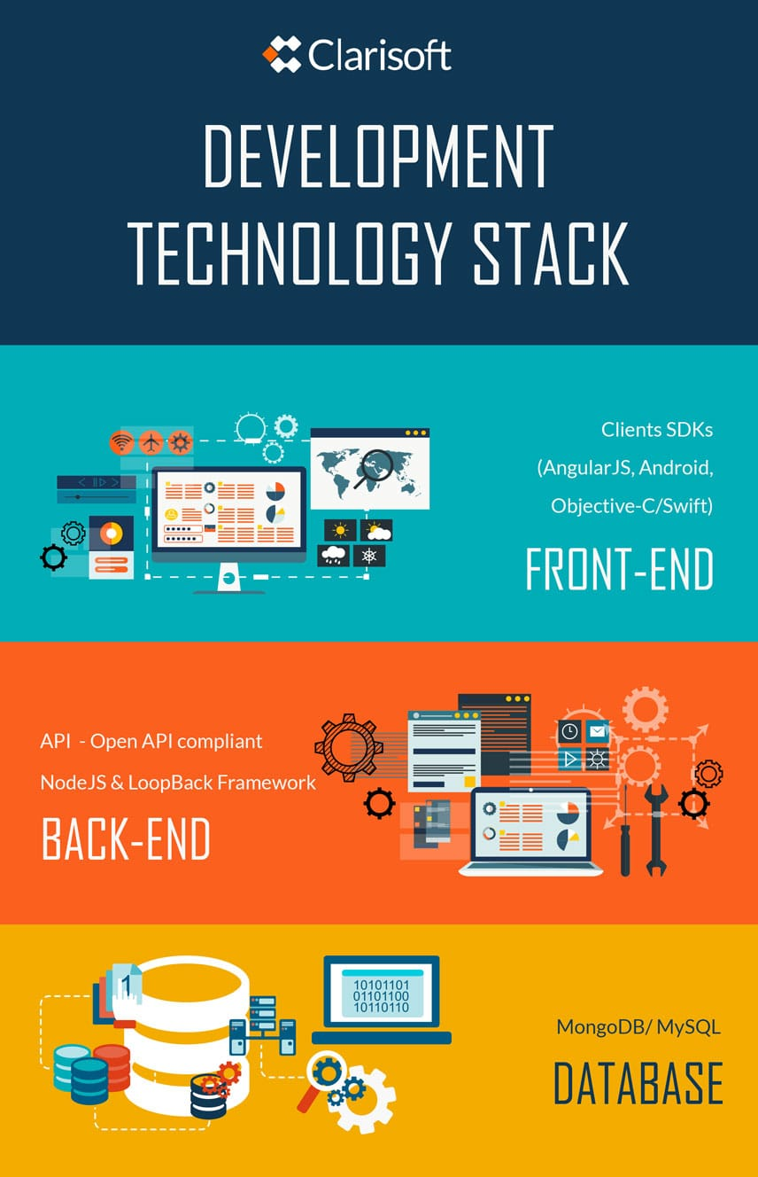
What is “Full-Stack”?

Slide 6
Building Blocks
Routes
Views
Database
Resources/Public
Controller

Slide 7
Web Frameworks
Flask
Laravel
Express
Django
Ruby on Rails

Slide 8
Today’s Tasks
Build an Express website using the Agile-Scrum framework
Add new routes
Add and modify views
Learn about HTTP requests and APIs using axios
Basics of test driven development

Slide 9
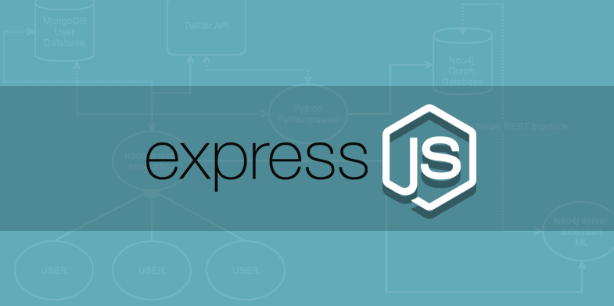
Express Framework

Slide 10
HTTP Methods
Method | Meaning
GET | Read data
POST | Insert data
PUT or PATCH | Update data
DELETE | Delete data

